Slide 1
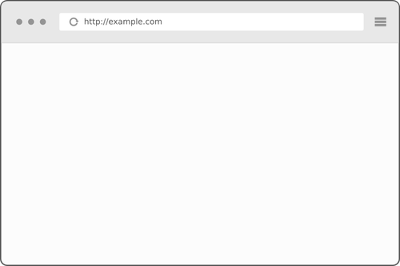
HandlerMapping
3
Controller
2
4
1
Browser
DispatcherServlet
ModelAndView
8
7
5
View
6
ViewResolver

